Slide 1
Module2_Problem_Solving
Reference: Russell, S. and Norvig, P. Artificial Intelligence - A Modern Approach, 4th edition, Prentice Hall, 2020-Chapter 3

Slide 2
Introduction to problem solving by searching methods
State space search
Uninformed search methods
Uniform cost method
BFS
DFS
Depth limited search

Slide 3
Introduction
Solving Problems by Searching: Concerned with how an agent can look ahead to find a sequence of actions that will eventually achieve its goal.
When the correct action to take is not immediately obvious, an agent may need to plan ahead:
by considering a sequence of actions that form a path to a goal state.
Such an agent is called a problem-solving agent, and the computational process it undertakes is called search.

Slide 4
Search algorithms
Informed algorithms, in which the agent can estimate how far it is from the goal.
Uninformed algorithms, where no such estimate is available.

Slide 5
Four-phase problem-solving process
The agent can follow this four-phase problem-solving process:
GOAL FORMULATION
PROBLEM FORMULATION
SEARCH
EXECUTION

Slide 6
Four-phase problem-solving process
Goal Formulation: The first and simple step in problem-solving. It organizes finite steps to formulate a target which require some action to achieve the goal. Today the formulation of the goal is based on AI agents.
Problem formulation: It is one of the core steps of problem-solving which decides what action should be taken to achieve the formulated goal. In AI this core part is dependent upon software agent which consists of various components to formulate the associated problem.

Slide 7
Four-phase problem-solving process
Search: It identifies all the best possible sequence of actions to reach the goal state from the current state. It takes a problem as an input and returns solution as its output.
Solution: It finds the best algorithm out of various algorithms, which may be proven as the best optimal solution.
Execution: It executes the best optimal solution from the searching algorithms to reach the goal state from the current state.

Slide 8
State Space
State Space is a set of possible states that the environment can be in.
Initial State: The state that the agent starts in.
an initial state for the problem which starts the AI agent towards a specified goal.
Goal State: A set of one or more goal states.
Sometimes there is one goal state. sometimes there is a small set of alternative goal states, and sometimes the goal is defined by a property that applies to many states (potentially an infinite number).
Example, in a vacuum-cleaner world, the goal might be to have no dirt in any location, regardless of any other facts about the state.

Slide 9
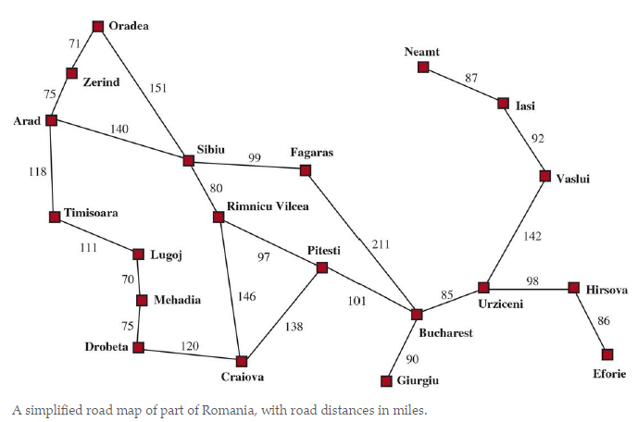
An Example Road Map

Slide 10
Search Problems and Solution
Action: The actions available to the agent.
Given a state s ACTIONS(s) returns a finite set of actions that can be executed in s.
Each of these actions is applicable in s.
This stage of problem formulation works with function with a specific class taken from the initial state and all possible actions done in this stage.
An example:
ACTIONS(Arad) = {ToSibiu, ToTimisoara, ToZerind}

Slide 11
Search Problems and Solution
Transition: A transition model, which describes what each action does.
RESULT (s,a) returns the state that results from doing action a in state s.
For example, RESULT(Arad, ToZerind) = Zerind
This stage of problem formulation integrates the actual action done by the previous action stage and collects the final stage to forward it to their next stage.

Slide 12
Search Problems and Solution
An action cost function:
An action cost function, denoted by ACTION-COST(s,a,s’) when we are programming or c(s,a,s’) when we are doing math, that gives the numeric cost of applying action a in state s to reach state s’).
A problem-solving agent should use a cost function that reflects its own performance measure.
Example, for route-finding agents, the cost of an action might be the length in miles or it might be the time it takes to complete the action.

Slide 13
Search Problems and Solution
A sequence of actions forms a path.
Solution is a path from the initial state to a goal state.
Assume that action costs are additive; that is, the total cost of a path is the sum of the individual action costs.
An optimal solution has the lowest path cost among all solutions.

Slide 14
Search Problems and Solution
The state space can be represented as a graph in which the vertices are states and the directed edges between them are actions.

Slide 15
Formulating problems
Romania Trip Problem: Formulation of the problem of “getting to Bucharest” is a model—an abstract mathematical description—and not the real thing.
Compare the simple atomic state description Arad to an actual cross-country trip, where the state of the world includes so many things: the traveling companions, the current radio program, the scenery out of the window, the proximity of law enforcement officers, the distance to the next rest stop, the condition of the road, the weather, the traffic, and so on.
All these considerations are left out of our model because they are irrelevant to the problem of finding a route to Bucharest.
The process of removing detail from a representation is called abstraction.
A good problem formulation has the right level of detail.
If the actions were at the level of “move the right foot forward a centimeter” or “turn the steering wheel one degree left,” the agent would probably never find its way out of the parking lot, let alone to Bucharest.

Slide 16
Formulating problems
Appropriate level of abstraction:
Think of the abstract states and actions we have chosen as corresponding to large sets of detailed world states and detailed action sequences.
Now consider a solution to the abstract problem: for example, the path from Arad to Sibiu to Rimnicu Vilcea to Pitesti to Bucharest.
This abstract solution corresponds to a large number of more detailed paths.
E.g.: one could drive with the radio on between Sibiu and Rimnicu Vilcea, and then switch it off for the rest of the trip.

Slide 17
Example Problems
The problem-solving approach has been applied to a vast array of task environments.
standardized problems
real-world problems
A standardized problem is intended to illustrate or exercise various problem solving methods.
It can be given a concise, exact description and hence is suitable as a benchmark for researchers to compare the performance of algorithms.
A real-world problem, such as robot navigation, is one whose solutions people actually use, and whose formulation is idiosyncratic, not standardized, because, for example, each robot has different sensors that produce different data.

Slide 18
Standardized problems – Vacuum World problem
A grid world problem is a two-dimensional rectangular array of square cells in which agents can move from cell to cell.
Typically the agent can move to any obstacle-free adjacent cell— horizontally or vertically and in some problems diagonally. Cells can contain objects, which the agent can pick up, push, or otherwise act upon; a wall or other impassible obstacle in a cell prevents an agent from moving into that cell.
The vacuum world can be formulated as a grid world problem as follows:
STATES: A state of the world says which objects are in which cells.
For the vacuum world, the objects are the agent and any dirt.
In the simple two-cell version, the agent can be in either of the two cells, and each call can either contain dirt or not, so there are 2 * 2 * 2 states.
In general, a vacuum environment with cells has n cells has n * 2^{n} states

Slide 19
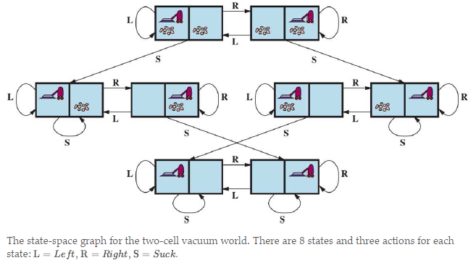
Standardized problems – Vacuum World problem
Example:

Slide 20
Standardized problems – Vacuum World problem
INITIAL STATE: Any state can be designated as the initial state.
ACTIONS: In the two-cell world we defined three actions: Suck, move Left, and move Right.
In a two-dimensional multi-cell world we need more movement actions.
We could add Upward and Downward, giving us four absolute movement actions, or we could switch to egocentric actions, defined relative to the viewpoint of the agent.
for example, Forward, Backward, TurnRight, and TurnLeft.
TRANSITION MODEL: Suck removes any dirt from the agent’s cell;
Forward moves the agent ahead one cell in the direction it is facing, unless it hits a wall, in which case the action has no effect.
Backward moves the agent in the opposite direction, while TurnRight and TurnLeft change the direction it is facing by90 degrees.
GOAL STATES: The states in which every cell is clean.
ACTION COST: Each action costs 1.

Slide 21
Standardized problems – Vacuum World problem
States: Based on dirt and robot location
Actions: Left, Right, Suck
Goal state: no dirt at all locations
Action Cost:1 per action

Slide 22
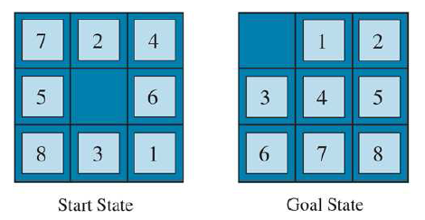
8 Puzzle Problem
8 Puzzle Problem is characterized by a 3×3 matrix with movable tiles numbered from 1 to 8 with a blank space. The tile adjacent to the blank space can slide into that space.
A typical instance of the 8-puzzle is in the diagram given below.

Slide 23
8-puzzle problem
STATES: A state description specifies the location of each of the tiles.
INITIAL STATE: Any state can be designated as the initial state
ACTIONS: While in the physical world it is a tile that slides, the simplest way of describing an action is to think of the blank space moving Left, Right, Up, or Down.
If the blank is at an edge or corner then not all actions will be applicable.
TRANSITION MODEL: Maps a state and action to a resulting state; for example, if we apply Left to the start state 5, the resulting state has the 5 and the blank switched.
GOAL STATE: Although any state could be the goal, we typically specify a state with the numbers in order, as given in the below example
ACTION COST: Each action costs 1
Goal test: It identifies whether we have reached the correct goal-state.
Path cost: The path cost is the number of steps in the path where the cost of each step is 1.

Slide 24
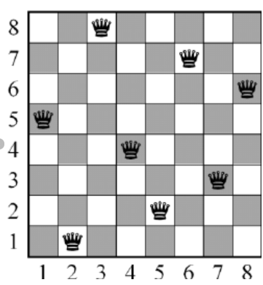
8 Queens problem
The aim of this problem is to place eight queens on a chessboard in an order where no queen may attack another. A queen can attack other queens either diagonally or in same row and column.

Slide 25
Real-world problems : Route-finding algorithms
Route-finding algorithms are used in a variety of applications. Some, such as Web sites and in-car systems that provide driving directions, are relatively straightforward extensions of the Romania example. (The main complications are varying costs due to traffic-dependent delays, and rerouting due to road closures.)
Others, such as routing video streams in computer networks, military operations planning, and airline travel-planning systems, involve much more complex specifications.
Consider the airline travel problems that must be solved by a travel-planning Web site:
STATES: Each state obviously includes a location (e.g., an airport) and the current time. Furthermore, because the cost of an action (a flight segment) may depend on previous segments, their fare bases, and their status as domestic or international, the state must record extra information about these “historical” aspects.
INITIAL STATE: The user’s home airport.
ACTIONS: Take any flight from the current location, in any seat class, leaving after the current time, leaving enough time for within-airport transfer if needed.
TRANSITION MODEL: The state resulting from taking a flight will have the flight’s destination as the new location and the flight’s arrival time as the new time.
GOAL STATE: A destination city. Sometimes the goal can be more complex, such as “arrive at the destination on a nonstop flight.”
ACTION COST: A combination of monetary cost, waiting time, flight time, customs and immigration procedures, seat quality, time of day, type of airplane, frequent-flyer reward points, and so on.

Slide 26
Example: Shortest path between VIT Vellore Campus To VIT Chennai Campus
To reach the campus in shortest route as well as cross the minimum number of Toll-gate’s
Formulate goal:
Shortest path
Formulate problem:
states: various urban areas
actions: drive between cities
Find solution:
sequence of urban areas, e.g., Kancheepuram, Thambaram, Kelambakkam, Guindy

Slide 27
Example: Shortest path between VIT Vellore Campus To VIT Chennai Campus
A problem is defined by four items:
Initial state e.g., "at Katpadi"
Actions ACTIONS(x) = set of action–state pairs
e.g., ACTIONS(Katpadi) = {ToWallaja , ToVellore, >, … }
Goal , can be
explicit, e.g., x = "at VIT Chennai"
implicit, e.g., Cross-Min no. of Toll-gate or Shortest path(x)
Action cost (additive)
e.g., sum of distances, number of actions executed, etc.
c(x,a,y) is the step cost, assumed to be ≥ 0
A solution is a sequence of actions leading from the initial state to a goal state

Slide 28
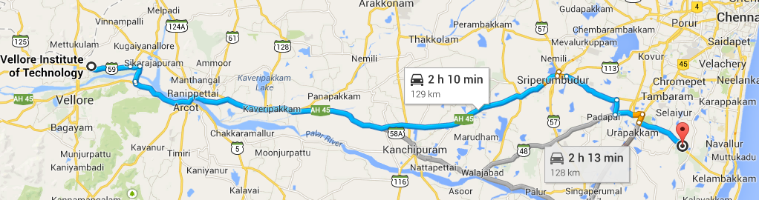
Example: Cont…

Slide 29
Search Algorithms
A search algorithm takes a search problem as input and returns a solution, or an indication of failure.
Consider algorithms that superimpose a search tree over the state-space graph, forming various paths from the initial state, trying to find a path that reaches a goal state.
Each node in the search tree corresponds to a state in the state space and the edges in the search tree correspond to actions.
The root of the tree corresponds to the initial state of the problem.

Slide 30
Search Algorithms
The state space describes the (possibly infinite) set of states in the world, and the actions that allow transitions from one state to another.
The search tree describes paths between these states, reaching towards the goal.
The search tree may have multiple paths to (and thus multiple nodes for) any given state, but each node in the tree has a unique path back to the root.

Slide 31
Search Algorithms
Steps in finding a path from Arad to Bucharest.
The root node of the search tree is at the initial state, Arad.
We can expand the node, by considering the available ACTIONS for that state, using the RESULT function to see where those actions lead

Slide 32
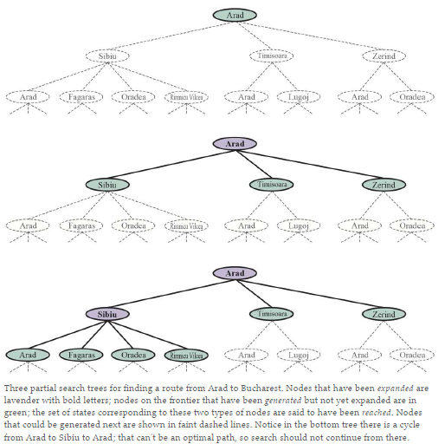
Search Algorithms

Slide 33
Search data structures
Search algorithms require a data structure to keep track of the search tree.
A node in the tree is represented by a data structure with four components:
node.STATE: the state to which the node corresponds;
node.PARENT: the node in the tree that generated this node;
node.ACTION: the action that was applied to the parent’s state to generate this node;
node.PATH-COST: the total cost of the path from the initial state to this node.
Following the PARENT pointers back from a node allows us to recover the states and actions along the path to that node.
Doing this from a goal node gives us the solution.

Slide 34
Search data structures
We need a data structure to store the frontier. The appropriate choice is a queue of some kind, because the operations on a frontier are:
IS-EMPTY(frontier) returns true only if there are no nodes in the frontier.
POP(frontier) removes the top node from the frontier and returns it.
TOP(frontier) returns (but does not remove) the top node of the frontier.
ADD(node, frontier) inserts node into its proper place in the queue.

Slide 35
Search data structures
Three kinds of queues are used in search algorithms:
A Priority queue first pops the node with the minimum cost according to some evaluation function, It is used in best-first search.
A FIFO queue or first-in-first-out queue first pops the node that was added to the queue first; we shall see it is used in breadth-first search.
A LIFO queue or last-in-first-out queue (also known as a stack) pops first the most recently added node; we shall see it is used in depth-first search.

Slide 36
Measuring problem-solving performance
Criteria used to choose among the various search algorithms : We can evaluate an algorithm’s performance in four ways:
COMPLETENESS: Is the algorithm guaranteed to find a solution when there is one, and to correctly report failure when there is not?
COST OPTIMALITY: Does it find a solution with the lowest path cost of all solutions?
Some authors use the term “admissibility” for the property of finding the lowest-cost solution, and some use just “optimality,” but that can be confused with other types of optimality.
TIME COMPLEXITY: How long does it take to find a solution? This can be measured in seconds, or more abstractly by the number of states and actions considered.
SPACE COMPLEXITY: How much memory is needed to perform the search?

Slide 37
Measuring problem-solving performance
Completeness:
Consider a search problem with a single goal.
That goal could be anywhere in the state space; therefore a complete algorithm must be capable of systematically exploring every state that is reachable from the initial state.
In finite state spaces that is straightforward to achieve: as long as we keep track of paths and cut off ones that are cycles (e.g. Arad to Sibiu to Arad), eventually we will reach every reachable state.

Slide 38
Measuring problem-solving performance
Time and space complexity are considered with respect to some measure of the problem difficulty.
In theoretical computer science, the typical measure is the size of the state-space graph, |V | + |E|, where |V | is the number of vertices (state nodes) of the graph and |E|is the number of edges (distinct state/action pairs).
This is appropriate when the graph is an explicit data structure, such as the map of Romania.
But in many AI problems, the graph is represented only implicitly by the initial state, actions, and transition model.
For an implicit state space, complexity can be measured in terms of the depth or number of actions in an optimal solution; the maximum number of actions in any path; and the branching factor or number of successors of a node that need to be considered.

Slide 39
Uninformed Search Strategies
An uninformed search algorithm is given no clue about how close a state is to the goal(s).
For example, consider our agent in Arad with the goal of reaching Bucharest.
An uninformed agent with no knowledge of Romanian geography has no clue whether going to Zerind or Sibiu is a better first step.
In contrast, an informed agent who knows the location of each city knows that Sibiu is much closer to Bucharest and thus more likely to be on the shortest path.
Uninformed search is a class of general-purpose search algorithms which operates in brute force-way.
It does not contain any domain knowledge such as closeness, the location of the goal.
It does not have additional information about state or search space other than how to traverse the tree, so it is also called blind search.
It examines each node of the tree until it achieves the goal node.

Slide 40
Uninformed Search Strategies
Algorithms:
Breadth-first search
Dijkstra’s algorithm or uniform-cost search
Depth-first search
Depth-limited and iterative deepening search
Bidirectional search

Slide 41
Breadth-first search
When all actions have the same cost, an appropriate strategy is breadth-first search
Root node is expanded first, then all the successors of the root node are expanded next, then their successors, and so on.
This is a systematic search strategy that is therefore complete.
This algorithm searches breadthwise in a tree or graph, so it is called breadth-first search.
BFS algorithm starts searching from the root node of the tree and expands all successor node at the current level before moving to nodes of next level.
Breadth-first search implemented using FIFO queue data structure.
Advantages:
BFS will provide a solution if any solution exists.
If there are more than one solutions for a given problem, then BFS will provide the minimal solution which requires the least number of steps.

Slide 42
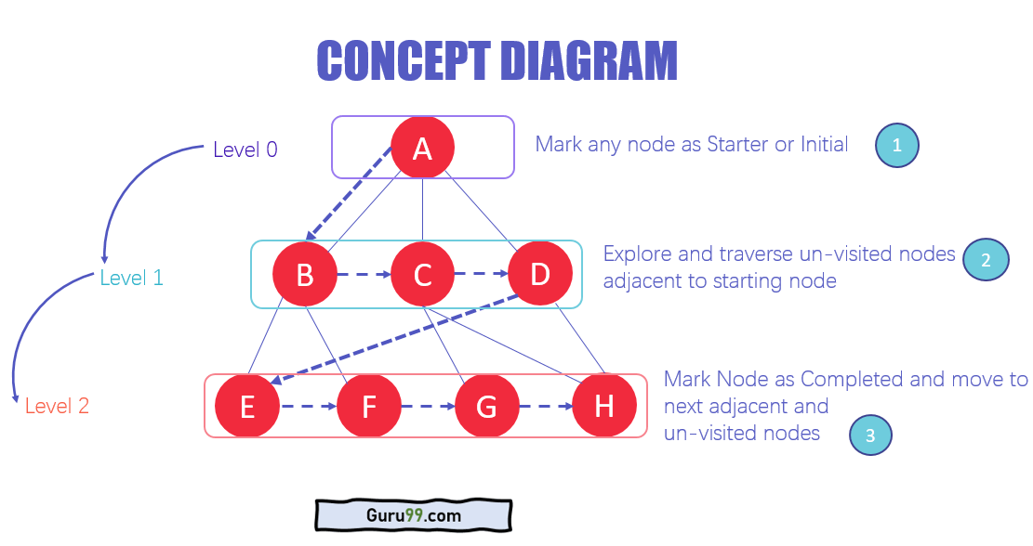
Breadth-first search
A first-in-first-out queue will be faster and will give us the correct order of nodes: new nodes (which are always deeper than their parents) go to the back of the queue, and old nodes, which are shallower than the new nodes, get expanded first.

Slide 43
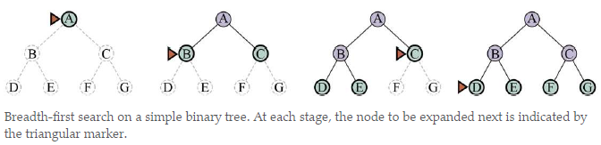
Breadth-first search
Example:

Slide 44
Breadth-first search
Breadth-first search always finds a solution with a minimal number of actions, because when it is generating nodes at depth d it has already generated all the nodes at depth d-1 so if one of them were a solution, it would have been found.
That means it is cost-optimal for problems where all actions have the same cost, but not for problems that don’t have that property.
It is complete in either case.
In terms of time and space, imagine searching a tree where every state has b successors.
The root of the search tree generates b nodes, each of which generates b more nodes, for a total of b² at the second level.
Each of these generates more nodes, yielding nodes at the third level, and so on.
Now suppose that the solution is at depth d.
Then the total number of nodes generated is
1 + b + b² + b³ +⋯+ b^{d} = O(b^{d})

Slide 45
Breadth-first search
Conclusion:
Complete? Yes (if b is finite)
Time? O(b^{d})
Space? O(b^{d}) (keeps every node in memory)
Optimal? Yes (if cost = 1 per step)
Space is the bigger problem

Slide 46
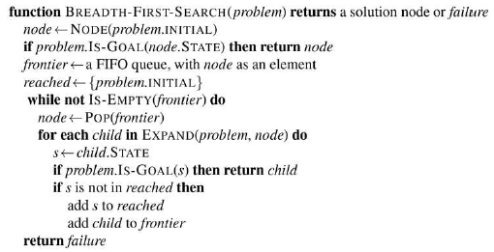
Breadth-first search
Algorithm:

Slide 47
Breadth-first search
Conclusion:
Complete? Yes (if b is finite)
Time? O(b^{d})
Space? O(b^{d}) (keeps every node in memory)
Optimal? Yes (if cost = 1 per step)
Space is the bigger problem

Slide 48
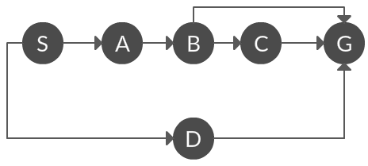
Breadth-first search
Which solution would BFS find to move from node S to node G if run on the graph below?

Slide 49
Breadth-first search
Conclusion:
Complete? Yes (if b is finite)
Time? O(b^{d})
Space? O(b^{d}) (keeps every node in memory)
Optimal? Yes (if cost = 1 per step)
Space is the bigger problem

Slide 50
Uniform-cost Search Algorithm
When actions have different costs, an obvious choice is to use best-first search where the evaluation function is the cost of the path from the root to the current node.
This is called Dijkstra’s algorithm by the theoretical computer science community, and uniform-cost search by the AI community.
Breadth-first search spreads out in waves of uniform depth—first depth 1, then depth 2, and so on
uniform-cost search spreads out in waves of uniform path-cost.

Slide 51
Uniform-cost Search Algorithm
Uniform-cost search is a searching algorithm used for traversing a weighted tree or graph.
This algorithm shall be used when a different cost is available for each edge.
Goal: To find a path to the goal node which has the lowest cumulative cost.
It expands nodes according to their path costs form the root node.
It can be used to solve any graph/tree where the optimal cost is in demand.
A uniform-cost search algorithm is implemented by the priority queue.
It gives maximum priority to the lowest cumulative cost.
Uniform cost search is equivalent to BFS algorithm if the path cost of all edges is the same.

Slide 52
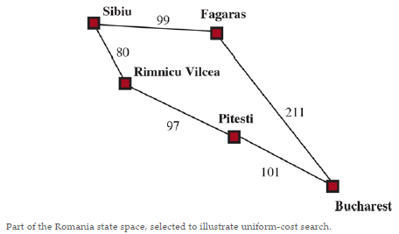
Uniform-cost Search Algorithm
Example:

Slide 53
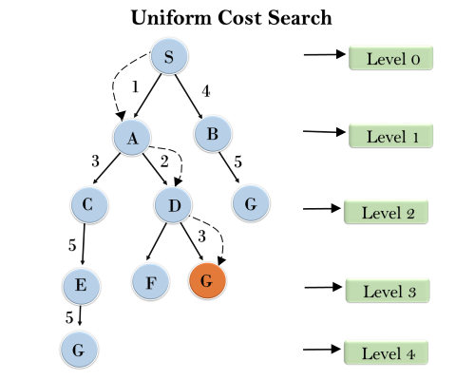
Uniform-cost Search Algorithm
Advantages: Uniform cost search is optimal because at every state the path with the least cost is chosen.
Disadvantages: It does not care about the number of steps involved in searching and only concerned about path cost. Due to which this algorithm may be stuck in an infinite loop.

Slide 54
Uniform-cost Search Algorithm
Completeness: Uniform-cost search is complete, such as if there is a solution, UCS will find it.
Time Complexity: Let C* is Cost of the optimal solution, and ε(a lower bound on the cost of each action) is each step to get closer to the goal node. Then the number of steps is = C*/ε+1. Here we have taken +1, as we start from state 0 and end to C*/ε.
Hence, the worst-case time complexity of Uniform-cost search is O(b^{1 + [C*/ε]}).
Space Complexity: The same logic is for space complexity so, the worst-case space complexity of Uniform-cost search is O(b^{1 + [C*/ε]}).
Optimal: Uniform-cost search is always optimal as it only selects a path with the lowest path cost.

Slide 55
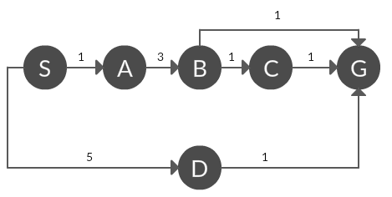
Uniform-cost Search Algorithm
Which solution would UCS find to move from node S to node G if run on the graph below?

Slide 56
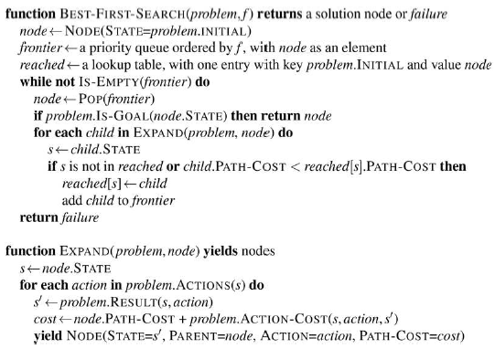
Uniform-cost Search Algorithm
Algorithm:

Slide 57
Depth-first search
Depth-first search is a recursive algorithm for traversing a tree or graph data structure.
It is called the depth-first search because it starts from the root node and follows each path to its greatest depth node before moving to the next path.
DFS uses a stack data structure for its implementation.

Slide 58
Depth-first search
The search proceeds immediately to the deepest level of the search tree, where the nodes have no successors.
The search then “backs up” to the next deepest node that still has unexpanded successors.
Depth-first search is not cost-optimal; it returns the first solution it finds, even if it is not cheapest.

Slide 59
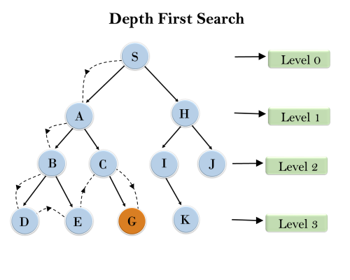
Depth-first search
Root node--->Left node ----> right node.
It will start searching from root node S, and traverse A, then B, then D and E, after traversing E, it will backtrack the tree as E has no other successor and still goal node is not found. After backtracking it will traverse node C and then G, and here it will terminate as it found goal node.

Slide 60
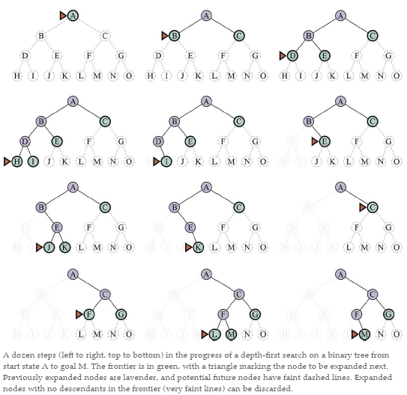
Depth-first search
Example:

Slide 61
Depth-first search
Complete? No: fails in infinite-depth spaces, spaces with loops
Modify to avoid repeated states along path
→ complete in finite spaces
Time? O(b^{m}): terrible if m is much larger than d
but if solutions are dense, may be much faster than breadth-first
Space? O(bm), i.e., linear space!
Optimal? No

Slide 62
Depth-limited search
A depth-limited search algorithm is similar to depth-first search with a predetermined limit.
depth-first search with depth limit l
Depth-limited search can solve the drawback of the infinite path in the Depth-first search. In this algorithm, the node at the depth limit will treat as it has no successor nodes further.
Depth-limited search can be terminated with two conditions of failure:
Standard failure value: It indicates that problem does not have any solution.
Cutoff failure value: It defines no solution for the problem within a given depth limit.
Advantages:
Depth-limited search is Memory efficient.
Disadvantages:
Depth-limited search also has a disadvantage of incompleteness.
It may not be optimal if the problem has more than one solution.

Slide 63
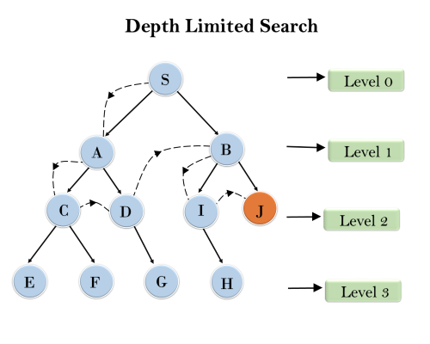
Depth-limited search
Example:

Slide 64
Depth-limited search
Completeness: DLS search algorithm is complete if the solution is above the depth-limit.
Time Complexity: O(b^{ℓ}).
Space Complexity: O(b×ℓ).
Optimal: Depth-limited search can be viewed as a special case of DFS, and it is also not optimal even if ℓ>d

Slide 65
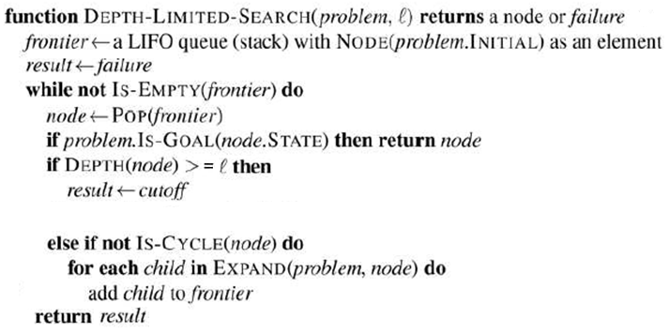
Depth-limited search
Algorithm:

Slide 66
Iterative deepening depth-first Search
The iterative deepening algorithm is a combination of DFS and BFS algorithms.
This search algorithm finds out the best depth limit and does it by gradually increasing the limit until a goal is found.
This algorithm performs depth-first search up to a certain "depth limit", and it keeps increasing the depth limit after each iteration until the goal node is found.
This search algorithm combines the benefits of Breadth-first search's fast search and depth-first search's memory efficiency.
The iterative search algorithm is useful uninformed search when search space is large, and depth of goal node is unknown.

Slide 67
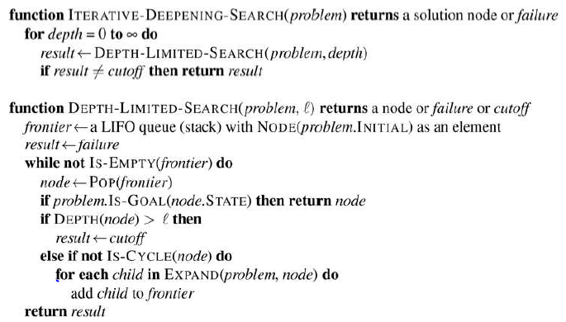
Iterative deepening depth-first Search
Algorithm:

Slide 68
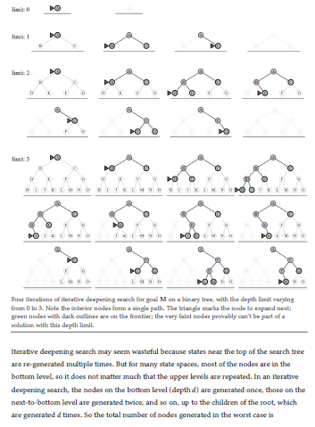
Iterative deepening depth-first Search

Slide 69
Iterative deepening depth-first Search
Complete? Yes
Time? O(b^{d})
Space? O(bd)
Optimal? Yes, if step cost = 1

Slide 70
Iterative deepening depth-first Search
Complete? Yes
Time? (d+1)b⁰ + d b¹ + (d-1)b² + … + b^{d} => O(b^{d})
Space? O(bd)
Optimal? Yes, if step cost = 1

Slide 71
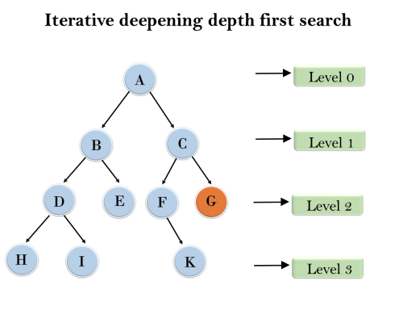
Iterative deepening depth-first Search
Example:
1'st Iteration-----> A 2'nd Iteration----> A, B, C 3'rd Iteration------>A, B, D, E, C, F, G 4'th Iteration------>A, B, D, H, I, E, C, F, K, G

Slide 72
Bidirectional Search Algorithm
Bidirectional search algorithm runs two simultaneous searches, one form initial state called as forward-search and other from goal node called as backward-search, to find the goal node.
Bidirectional search replaces one single search graph with two small subgraphs in which one starts the search from an initial vertex and other starts from goal vertex. The search stops when these two graphs intersect each other.
Bidirectional search can use search techniques such as BFS, DFS, DLS, etc.
Advantages:
Bidirectional search is fast.
Bidirectional search requires less memory
Disadvantages:
Implementation of the bidirectional search tree is difficult.

Slide 73
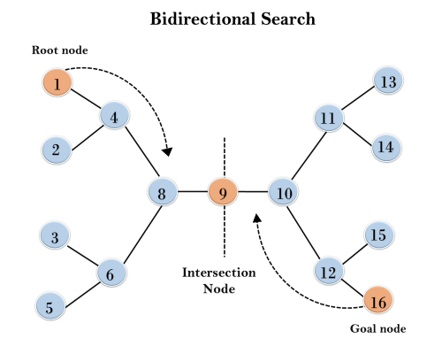
Bidirectional Search Algorithm
In the below search tree, bidirectional search algorithm is applied.
This algorithm divides one graph/tree into two sub-graphs.
It starts traversing from node 1 in the forward direction and starts from goal node 16 in the backward direction.
The algorithm terminates at node 9 where two searches meet.

Slide 74
Bidirectional Search Algorithm
Completeness: Bidirectional Search is complete if we use BFS in both searches.
Time Complexity: O(b^{d/2}).
Space Complexity: O(b^{d/2}).
Optimal: Bidirectional search is Optimal.

Slide 75
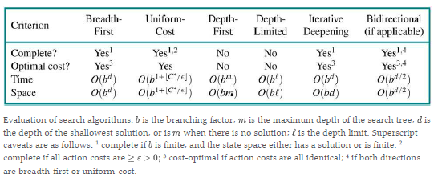
Comparing uninformed search algorithms
Summary

